Slide 1
Team Queen’s Gambit Project: Chess Mert Olpak Sevki Can Sentuna Date: 10.01.2021

Slide 2
Project Description: 2 player chess game which has save and load features with a stopwatch. All the rules are defined to the program same as the real chess game.
Team member roles:
Sevki Can Sentuna: Defining the functional in game algorithms and writing the rules. Such as checkmate function, check features etc.
Mert Olpak: Defining the various in game instruments and save & load game features. Such as stopwatch func., printboard func. Etc.

Slide 3
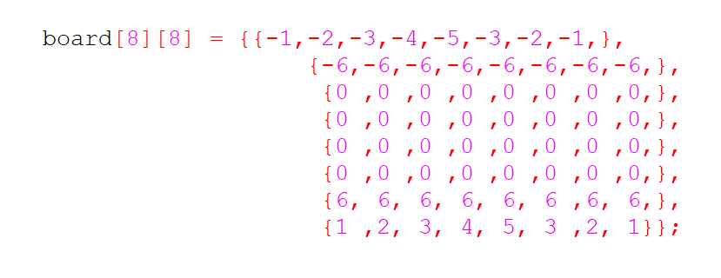
0 = Free Square
1 = White Castle
2 = White Knight
3 = White Bishop
4 = White Queen
5 = White King
6 = White Pawn
0 = Free Square
-1 = Black Castle
-2 = Black Knight
-3 = Black Bishop
-4 = Black Queen
-5 = Black King
-6 = Black Pawn

Slide 4
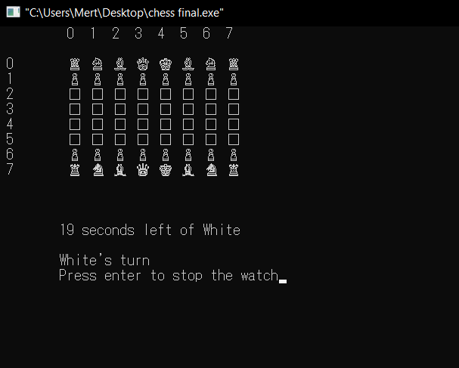
Appereance of the board during the game

Slide 5
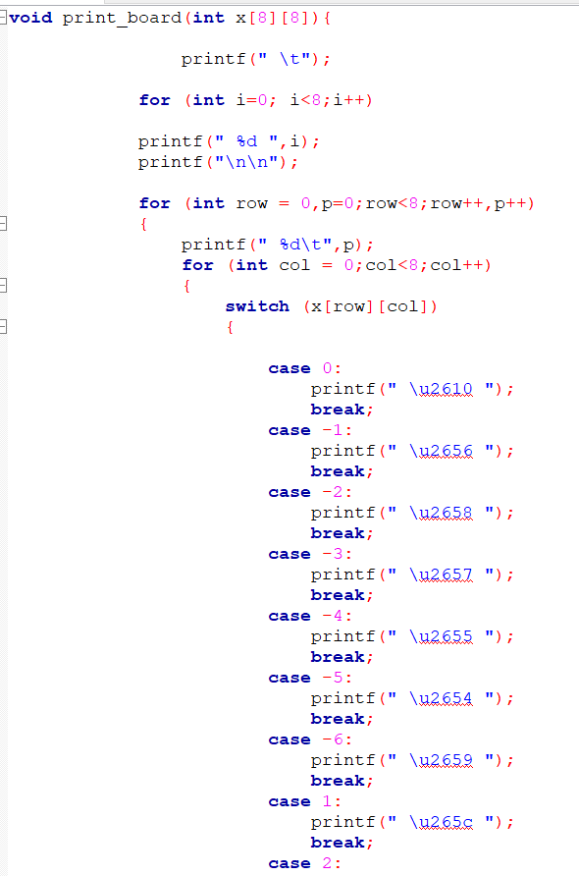
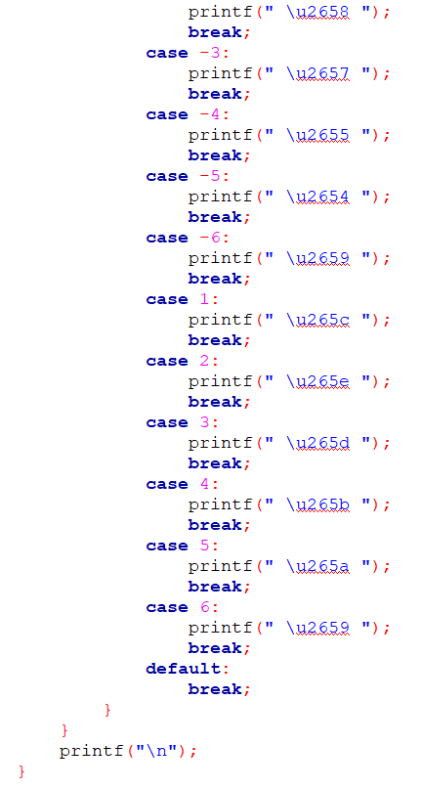
We have basically used the unicodes you have you recommended us for the pieces.
A switch navigates the values in matrix to related unicodes.

Slide 6
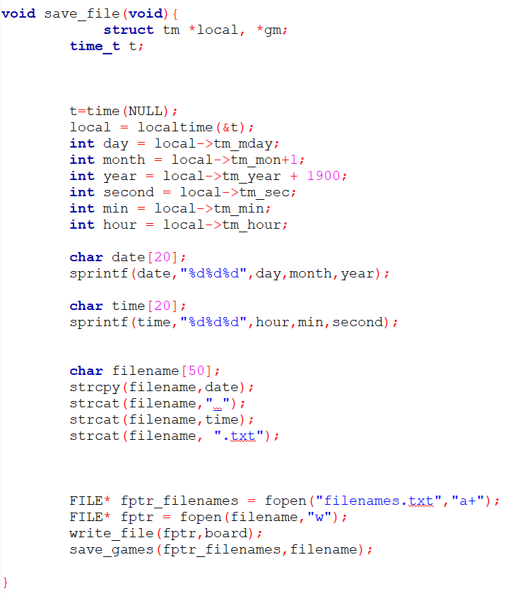
How do we save the games ?
write_file()
and
save_games
are defined before.

Slide 7
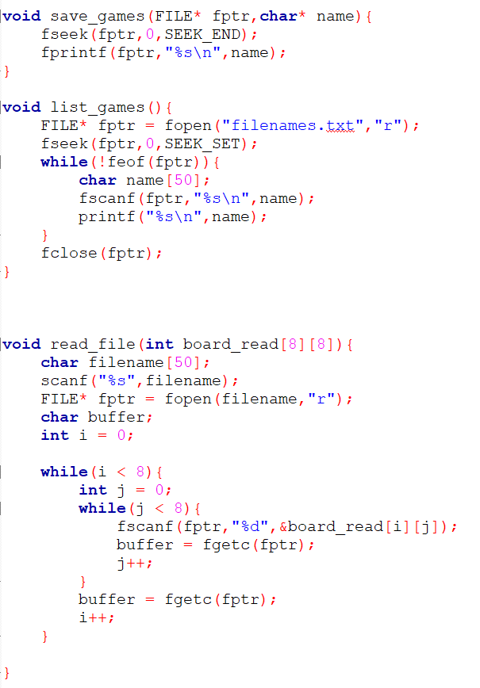
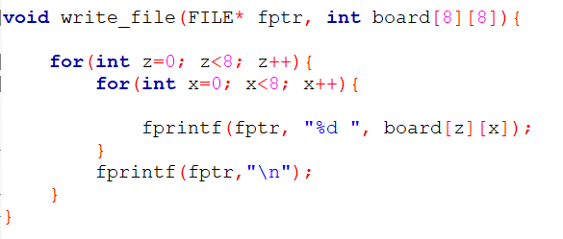
A function which saves the games to the list
Saved Games Lister
Single Game Board Saver
Saved Board Reader

Slide 8
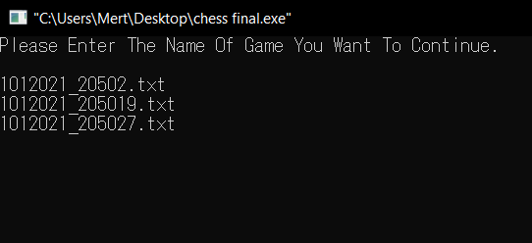
Apperance of the Load Game Screen

Slide 9
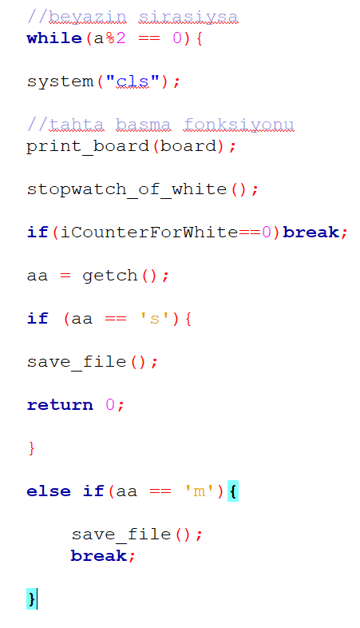
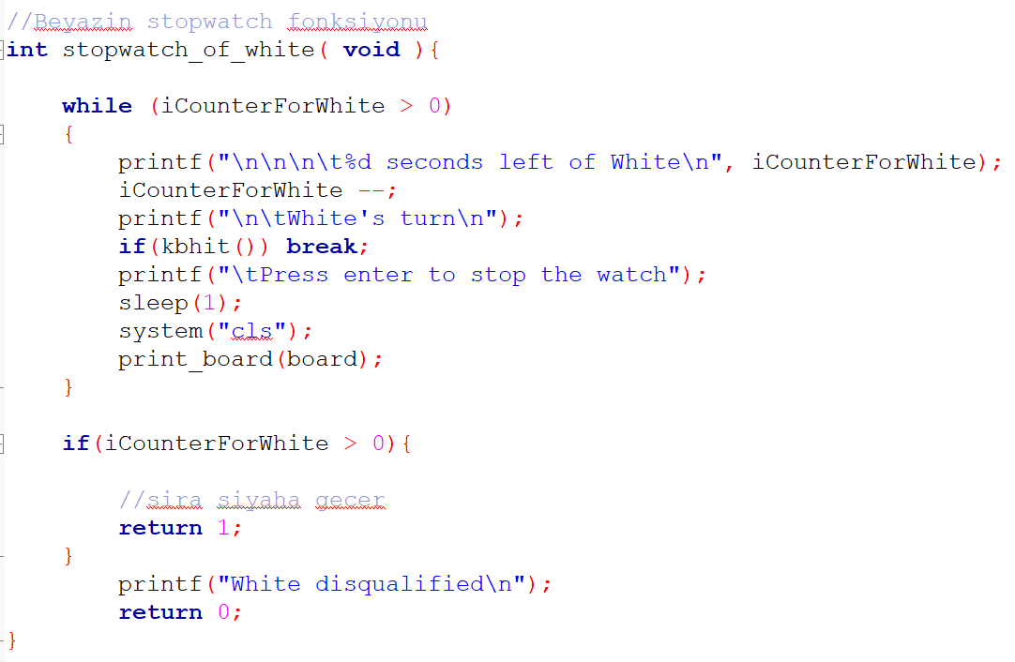

Slide 10
Functions and algorithms that will be covered :
is_valid_move_black() and is_valid_move_white()
Castling algorithm
Horizontal, vertical and diagonal check algorithms
black_king_check_for_surroundings() and white_king_check_for_surroundings
white_checkmate_controller and black_check_mate_controller

Slide 11
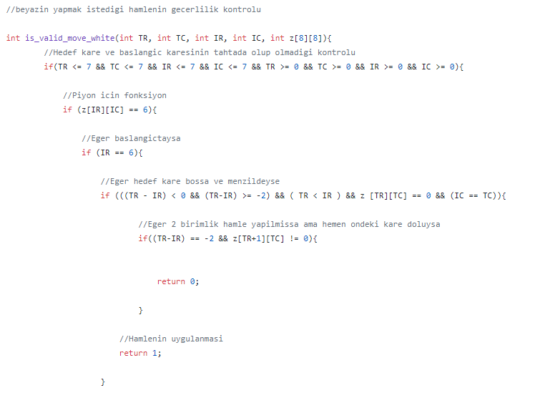
is_valid_move_white():
All white pieces are defined in the function ‘is_valid_move_white()’ and same as the black pieces.
For this particular example the pawn is defined. If user tries to commit an illegal move, ‘ invalid move !’ prints out.
Every characteristic properties of the pieces are defined in the same function.

Slide 12
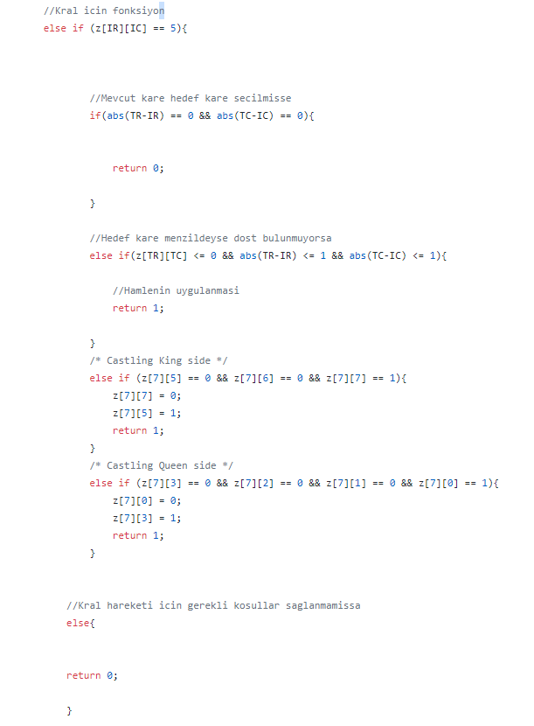
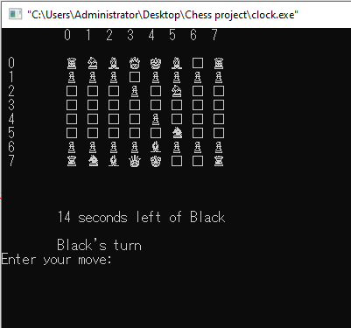
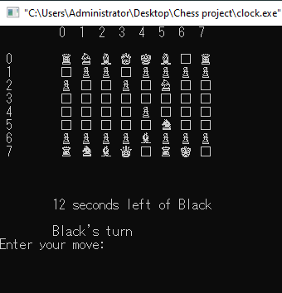
Castling King side and Queen side:
Castling happens when there are no piece between the King and the Rook.

Slide 13
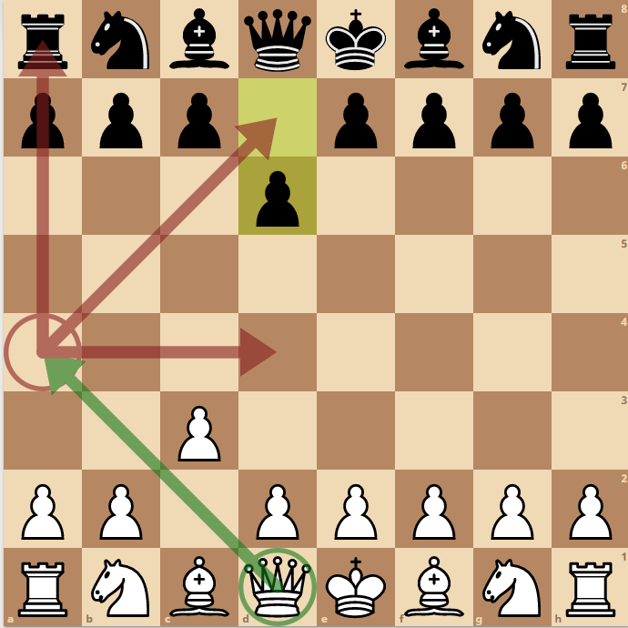
Checking functions:
Our referance should be the target square (TR, TC).
We scan through all squares vertically, horizontally and diagonally.
Those functions are chosen to be built seperated and applied seperated one by one.
For example, we need to apply vertical, horizontal and diagonal functions to Queen while we apply only diagonal function to the Bishop.

Slide 14
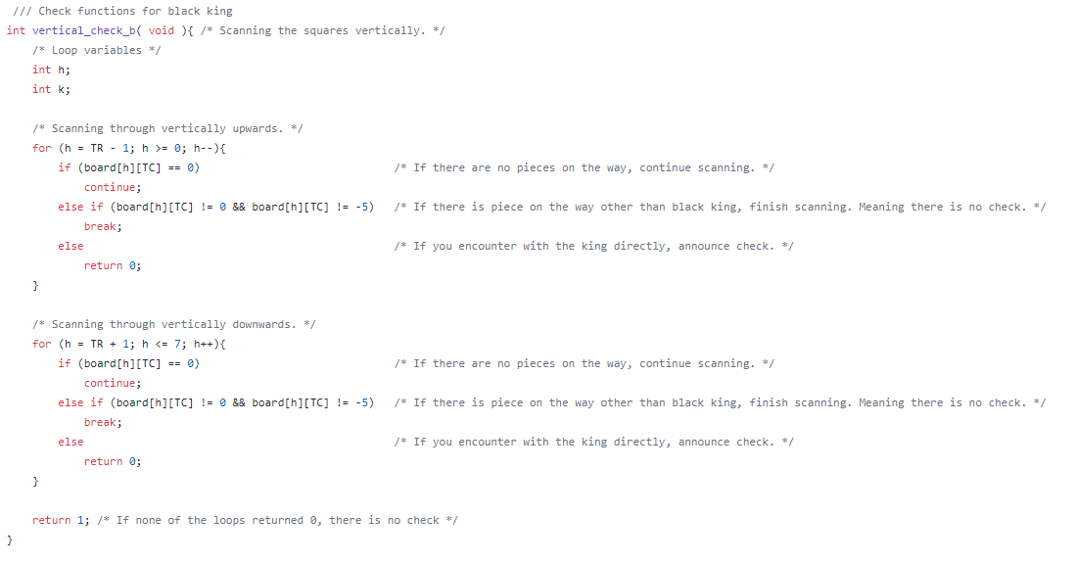
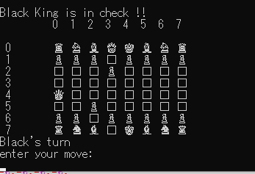
Checking functions (continued):

Slide 15
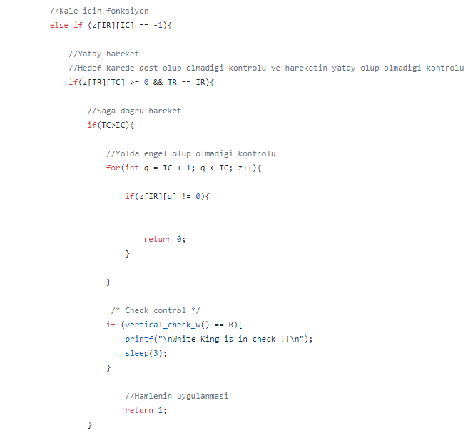
Checking functions (continued):
And finally, that is the application of the functions in is_valid_move() functions.
This particular example shows the implementation in the black Rook.
Only vertical check function is defined.

Slide 16
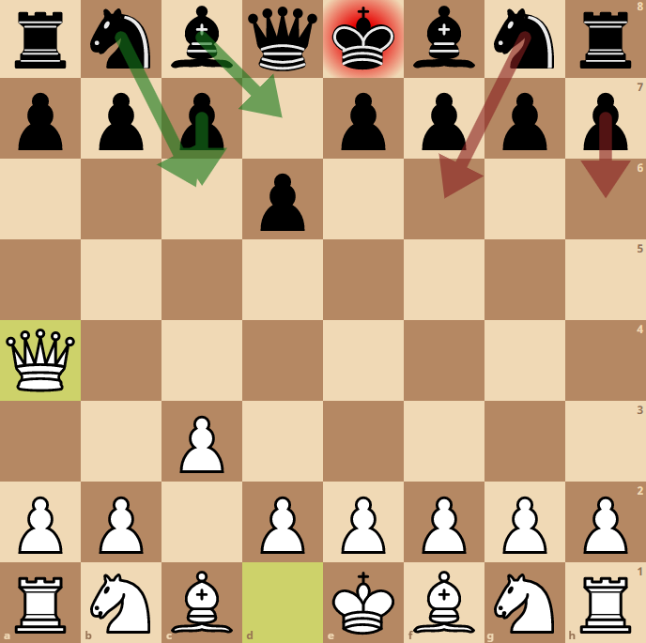
Checking functions (continued):
Now our problem is that black’s next moves are restricted.
How can we solve that ?

Slide 17
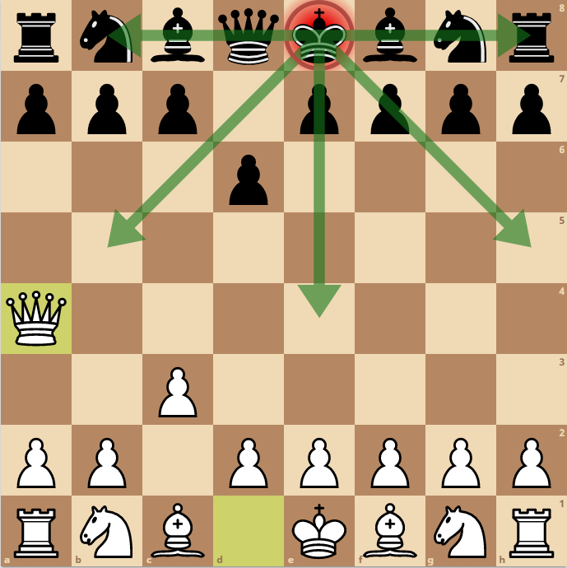
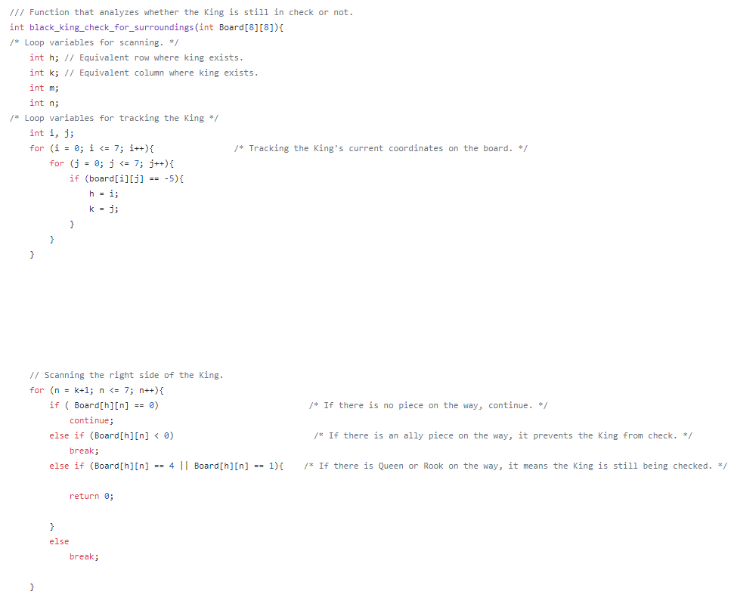
Black_king_check_for_surroundings()

Slide 18
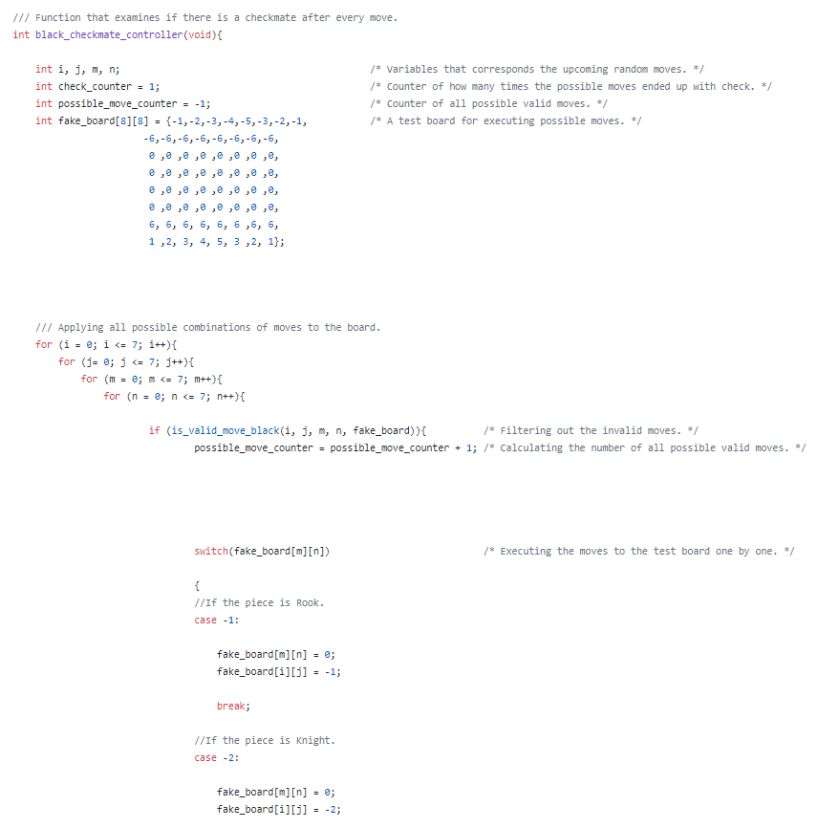
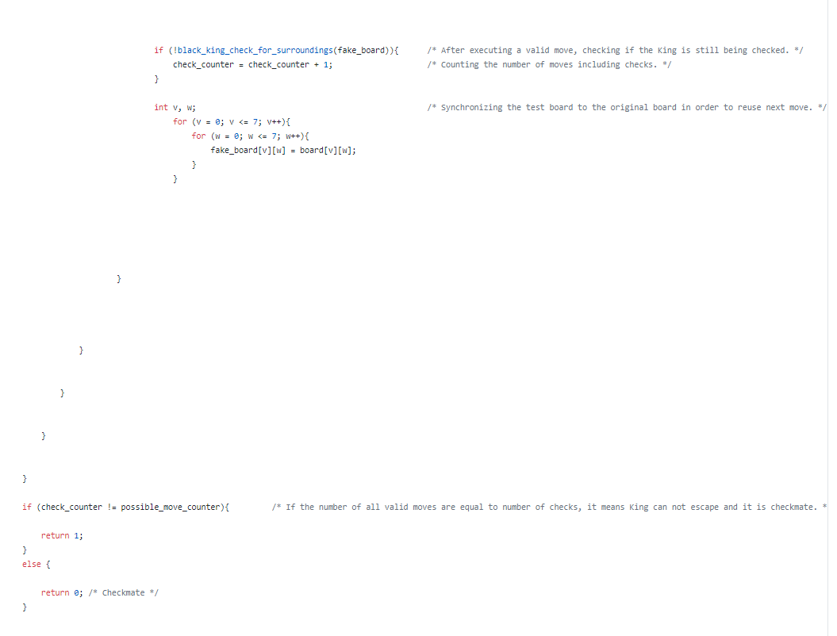
How about checkmate ?
Checkmate happens when the King cannot be prevented from checking.

Slide 19
Discussion
What are the problems that we encountered the most ?

Slide 20

Demo

